Slide 1
Day 5: Paper Writing
Prof. Shengdong Zhao

Slide 2
Two types of writing
Writing as planning (stage 1)
Writing for submission (stage 2)

Slide 3
Characteristics of the two types of writing
Writing as planning
Answering specific questions you have at different stages
Informal & minimalistic
Logical flow is more important than the word choices
May not be used for the final paper
Writing for submission
Construct the best possible story based on the results
Every (little) details matters
Progressive
Marketing

Slide 4
Writing as planning

Slide 5
Writing as planning - the purpose
Answer questions you have at different stage:
What’s the big idea?
What’s the major components of the paper and how are they connected?
How should I design a study?
…

Slide 6
Writing as planning - the method
Depending on the type of questions you want to answer, there are different writing tools:
What’s big idea?
Write an abstract to find out
How to design a fair pilot study to check for the results?
Write a brief study outline
What’s the main components of the paper?
Write a brief paper outline
How to design a formal study?
Write a detailed study design outline
How does the results look like?
Write a detailed result outline

Slide 7
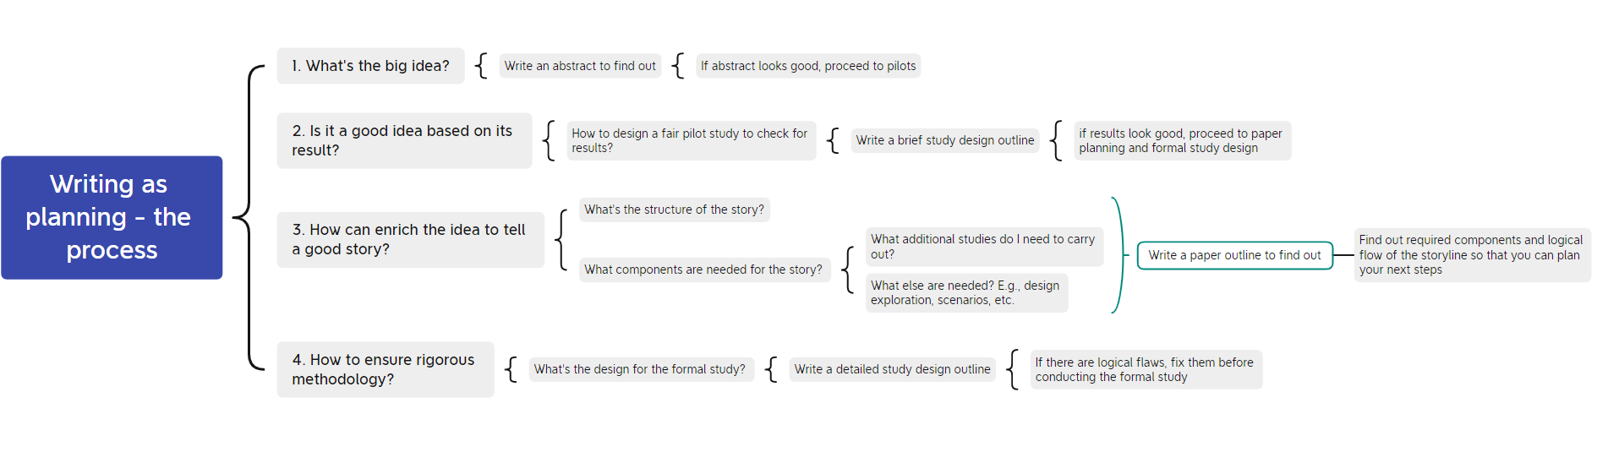
Writing as planning - the process

Slide 8
How to write an effective outline?
https://docs.google.com/document/d/1GXL5KxFOsTgZ4hND9-6CjWTauCa6ic6iOF8Deimt7xQ/edit#heading=h.srvwphsc5and

Slide 9
Writing for submission

Slide 10
Writing as submission - the purpose
Maximize the chance of paper acceptance
Storytelling
Logical and evidence driven
Complete, clear, concise
Marketing

Slide 11
Writing for submission - the method
Reverse engineering
Start from the results (your evidence), and build a story around them
Two stages: content first, then marketing
Question: why this approach and why not start with introduction?

Slide 12
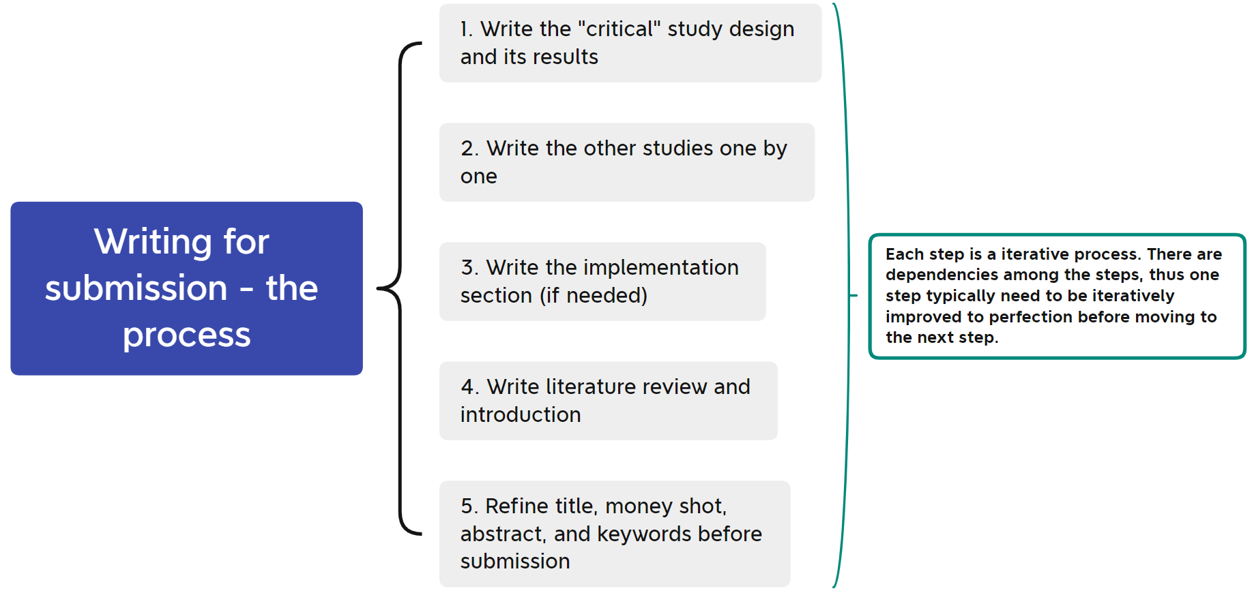
Writing for submission - the process

Slide 13
What does an ideal paper look like?

Slide 14
The “perfect” paper
Good problem
Nice setup of the issues
“Cut off” any potential arguments/dissent
Good literature review
One good solution to the problem
Data to show that solution is better
Quality of writing, images, attention to detail
Adapted from Ravin Balakrishnan talk

Slide 15
Too simple
Perfect
Too complex
Results are obvious
Not enough details to understand the study design/implementation
2-3 studies each with multiple factors with important, clear, results
The right amount of details in study design and implementation
Too many ideas
More than 3 full studies
Too many features
Too much technical details

Slide 16
Why avoid too complex?

Slide 17
Review process
1 PC member assigned to your paper
This person typically has 10 other papers
3-5 non-PC reviewers per paper
These people each have 10 other papers
Likely will spend ~half hour on your paper, max
2nd PC member may read contentious papers
Papers meeting
Reputations count
DO NOT send a paper in “just to get feedback”

Slide 18
Writing for submission
Section by section tips

Slide 19
Components of a paper
Abstract
Succinct summary of problem, solution, results
Introduction
Summary of problem & what you did
Brief summary of results
Contributions of the paper
Money shot
Expectation management
Related Work
Pay homage to those who will review your paper
The stuff you did, followed by results
Conclusions
Reiterate your contributions. Explicitly!
References
Video

Slide 20
abstract :=
( ) summary of your findings
( ) teaser to make people read your paper
( ) motivation for your paper

Slide 21
abstract :=
( ) summary of your findings
( ) teaser to make people read your paper
( ) motivation for your paper

Slide 22
abstract blueprint (technique paper)
<Users> trying to perform <task> fail, because the <bestKnownSolution> has <limitation>. In this paper, we present <proposedSolution>. It overcomes <limitation> by <newFeatureOrApproach>.
[If you have a user study add…
In a user study, participants completed <task> <percentage> faster/more accurate when using <proposedSolution> than when using <bestKnownSolution>.]

Slide 23
introduction :=
:= the shortest path between a commonly believed fact and the research question you are answering in your paper

Slide 24
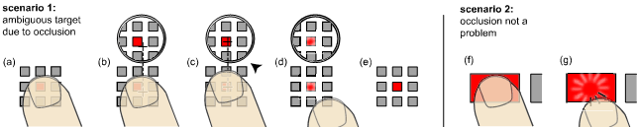
example (shift CHI’07)
to save time for retrieving the stylus, users operate PDAs using touch
finger tip size and occlusion make acquisition of small targets hard
🡪 zooming does not fix that occlusion (see section “user test paper”)
🡪 offset cursor solves the problem, but has three drawbacks
we propose Shift. It solves the problem while avoiding the 3 drawbacks

Slide 25
example (shift CHI’07)
Many pen-based devices, such as personal digital assistants (PDAs), mobile phone-PDA hybrids, and ultra mobile personal computers (UMPCs) utilize sensing technologies that can track not only a stylus, but also touch input. This makes touch input an option when pen input is not possible, such as one-handed operation [14]. Moreover, many users choose to use their finger to save the time required to retrieve the pen – especially for intermittent short interactions such as verifying a meeting time, navigating a map, or controlling a media player. However, pen-based user interfaces often contain small dense targets, making selection with a finger slow and error prone.
So what is it that users give up by not using the pen? While fingers are somewhat less accurate than pens in terms of fine control [2], accuracy is not the primary reason for the high error rate. In our observation, the main reason is the ambiguous selection point created by the finger’s contact area in combination with the occlusion of the target. When selecting targets smaller than the size of the finger contact area, users start having difficulty determining whether or not they have acquired the target. Unfortunately, targets smaller than the finger’s contact area are also occluded by the finger, preventing users from seeing visual feedback.
The purpose of the pen is to minimize occlusion by creating a vertical offset between the user’s hand and the screen and to clearly define the selection point. Consequently, applying a technique to enhance accuracy will not solve the problem. Manipulating control display (CD) ratio [1,5] or offering in-situ zooming [1,5,17] enhance accuracy, but they do not address occlusion directly or define a clear selection point.
Occlusion and selection point ambiguity can be addressed with the Offset Cursor [18,21] (Figure 3). The Offset Cursor creates a software pointer a fixed distance above the finger’s contact point. The Offset Cursor uses take-off selection [18,19] in which the target is selected at the point where the finger is lifted rather than where it first contacted the screen. This allows users to touch the screen anywhere and then drag the pointer into the target. Offset Cursor is in many ways a software version of a stylus: its pointer provides a unique selection point and it addresses occlusion by creating an offset between pointer and finger (in the image plane rather than above it, as the pen does).
However, the use of the Offset Cursor technique comes at a price. First, with Offset Cursor users cannot aim for the actual target anymore. Instead, they need to compensate for the offset by touching some distance away. Since there is no visual feedback until contact, users cannot always reliably predict the offset and need to iterate more. In our experimental evaluation we saw evidence of this with Offset Cursor acquisition time 1.57 times slower for targets large enough to select with the bare finger. Second, a constant offset distance and direction makes some display areas unreachable. For example, placing the pointer above the finger makes a corresponding strip along the bottom of the screen inaccessible. Although one could vary the offset direction depending on screen location, this would only exacerbate the difficulty in compensating for the offset, introducing even more corrective movement. Third, on first use, users are unlikely to expect the offset, aim directly for the actual target, and miss. While this is less of a concern in the case of a personal device, using Offset Cursor in a walk-up context like a kiosk may be questionable.
To address these disadvantages, we propose Shift. In addition to offsetting the pointer, Shift offsets the screen content to avoid all three drawbacks of Offset Cursor and leads to significantly better targeting performance.
one paragraph for each logical step in your argument

Slide 26
example (shift CHI’07)
write in logical order, not the chronological order in which you came up with it (this is not a diary)
to save time for retrieving the stylus, users operate PDAs using touch
finger tip size and occlusion make acquisition of small targets hard
🡪 zooming does not fix that occlusion (see section “user test paper”)
🡪 offset cursor solves the problem, but has three drawbacks
we propose Shift. It solves the problem while avoiding the 3 drawbacks

Slide 27
fame or shame
the intro of a paper at a mobile conference opens with:
“In this year alone, more mobile phones will be sold than PCs in their entire history combined”
shame: true for any paper on mobile interaction. (reviewers read this 10 times per conference).
If you need more than, say, 6 paragraphs you are probably underestimating your audience and started too far back.
Better: consider deleting the first paragraphs.

Slide 28
fame or shame
“There is a huge number of 3D applications including… <list of examples>. <What you do for them>”
Shame: Don’t try to persuade readers with your opinion, you will achieve the opposite effect (if it was true, why would authors try to hammer it home so badly?)
Better Convince them with fact “3D applications, such as <examples>…

Slide 29
contribution :=
:= one or more things that have never been done and that matter

Slide 30
science contribution: you learned something about nature
engineering contribution: you made something that works better than before

Slide 31
your contribution is the most important part of your paper, it is the reason why you are writing it
spend as much space on your contribution as possible; spend as little space as possible on non-contributions, such as the web server you had to set up (even if you spent 80% of your time on it)
make sure everybody gets your contribution list the top 1-2 in the abstract. Consider stating your contributions again more explicitly at the end of the intro

Slide 32
related work :=
show how your paper integrates itself into your field = a set of parent nodes in a graph structure

Slide 33
If you review a paper, you probably do mind if authors
1. misspell your name
2. skip your work even though it is directly related
3. get the formatting wrong
4. list why your work sucks (rather than simply acknowledge its “limitations”)
so don’t do these to others. Respect your reviewers and their work. (practical reason: people you reference (and committee members) are likely to be reviewers)

Slide 34
tips
you need to say how you are different only for the most relevant 1-3 key pieces of related work. For all others just write “<authors> did <project>.”
Mention limitations and drawbacks in a sentence, not a paragraph

Slide 35
conclusions :=
sit back and think about what you have learned on a very high level. Insights that you can share now, that would not have made sense before people have read the paper.
(In the case of a foot project e.g., what you learned about feet.)

Slide 36
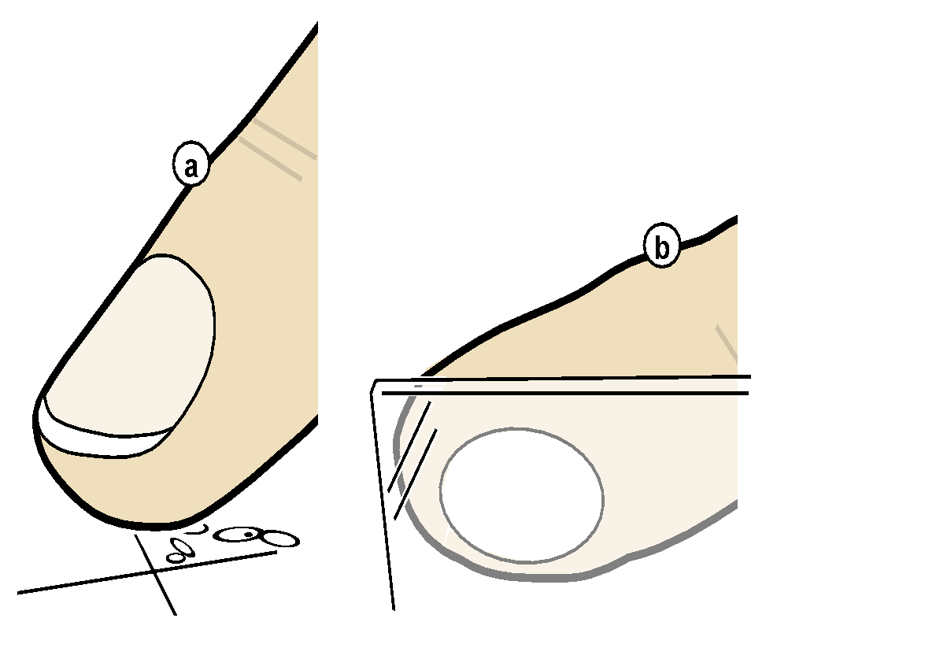
ridgepad
CONCLUSIONS AND FUTURE WORK
In this paper, we made two types of contribution.
On the one hand, we made a technical contribution. The RidgePad device achieved 1.8 times higher accuracy than simulated capacitive and we demonstrated that the use of high precision 3D tracking can more than triple touch accuracy. This substantial increase in accuracy can be used to make touch interfaces more reliable or to pack up to 10 times more controls into the same touch surface. Future versions of the optical tracking device might achieve a smaller footprint by using cameras placed in the corners of the screen. A more distant future version of RidgePad might leverage in-cell technology to bring touch input to very small mobile devices, such as interactive watches and rings.
On the other hand, we made a contribution in the theoretical domain, which we tend to think of as at least equally important. We introduced a new model for touch inaccuracy, the generalized perceived input point model. We presented a user study, the findings of which are congruent with our new model, while they refute the fat finger problem, which was traditionally considered the primary source of touch inaccuracy.
This paper also contributes a new perspective on touch. Touch has traditionally been considered a 2D phenomenon, most likely because touch screen interaction required only two coordinates, i.e., an x/y coordinate pair. The proposed model, in contrast, establishes touch as a phenomenon of not only the touch surface, but of a wider context of three-dimensional factors. While we primarily investigated the user’s finger posture in 3-space, this wider context may include additional factors, such as head position, device orientation, parallax, and so on. Tracking these additional factors might allow future devices to realize even larger improvements in touch accuracy. Additional research is required here.
Finally, we learned about users. We found that users are not inaccurate—they are just different. The most likely explanation for this difference is that touch on a millimeter scale was never defined in the first place. For targets on this almost microscopic scale, pointing means to “dock” a comparably large, asymmetric object with a tilted surface. Comparing the arrangement of ovals across Figure 5 clearly shows that no two participants of our study had the same mental model of how to accomplish this. Contact area—the determining factor in today’s touch technology—might be a factor, but clearly only one of many. Additional research is required to reach a new and more detailed understanding of users’ mental models of touch.

Slide 37
Marketing related issues

Slide 38
1. how more people will glance at it?
2. how many people will skim it?
3. how many people will read your paper?
to make sure every “reader” gets your point tell the story multiple times at different levels of detail
Quite a lot
Among them, some will skim it
Very few

Slide 39
system name (= 1 word) example: “earPod”, “halo”
title (= 1 sentence) “Fisheyes are good for large steering tasks” [Gutwin]
figure 1 on pg1 and self-contained caption (= 1 image)
abstract (= 1 paragraph)
walkthrough right after intro (= 1 section)
paper in all its detail (= 1 paper)

Slide 40
name
#times read
title
figure
abstract
walk- through
paper

Slide 41
project name :=
( ) is the shortest summary of your project
( ) conveys a picture
( ) adding terms like “smart” get readers excited
( ) explains the project
( ) is memorable

Slide 42
project name :=
( ) is the shortest summary of your project
( ) conveys a picture
( ) adding terms like
( ) explains the project
( ) is memorable
“smart” get readers excited

Slide 43
your project name will be used a lot!
(throughout the paper + every time you talk about it +
every time anyone talks about it)
🡪 Ideally, it pitches the entire project allows people to guess what it does + benefits

Slide 44
“SmartNails” Terrible. Avoid meaningless fill and advertising words, such as “smart <whatever>”
“G.R.A.P.E.S.” Terrible. An acronym is typically the worst solution
“suggestive interfaces” bad, check connotation
“mad” bad: neither Google Unique nor Domain available
“Generalized Perceived Input Point Model” Bad Avoid terms so long that you feel you need an acronym
Phlat. Bad. Avoid the need to spell—you are wasting elevator time. A dictionary word with a typo is bad. Avoid dashes in URLs

Slide 45
fame or shame
“play anywhere” for a mobile projector with touch
“Soap” for an input device users flip in their hand
“GroupLens” for a news recommender
“Skinput” for touch input on the user’s arm

Slide 46
figure1

Slide 47
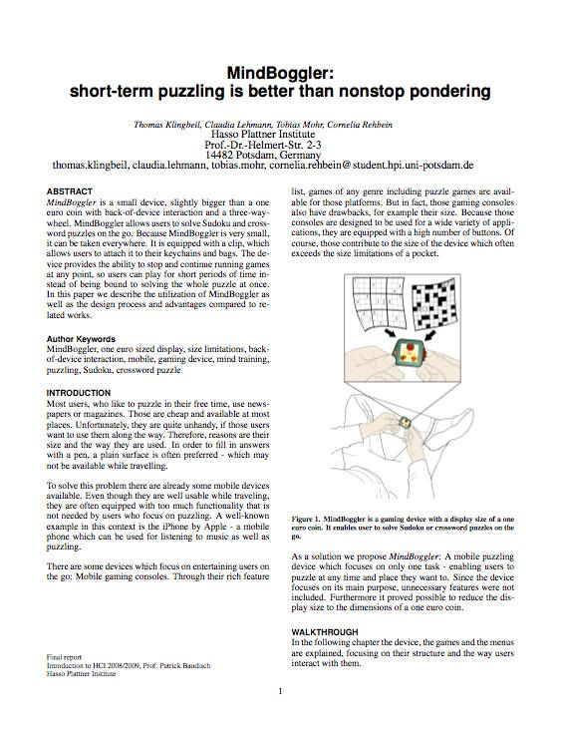
figure 1: shows everything in one picture
equally important: the caption says it all in 1-2 sentences

Slide 48
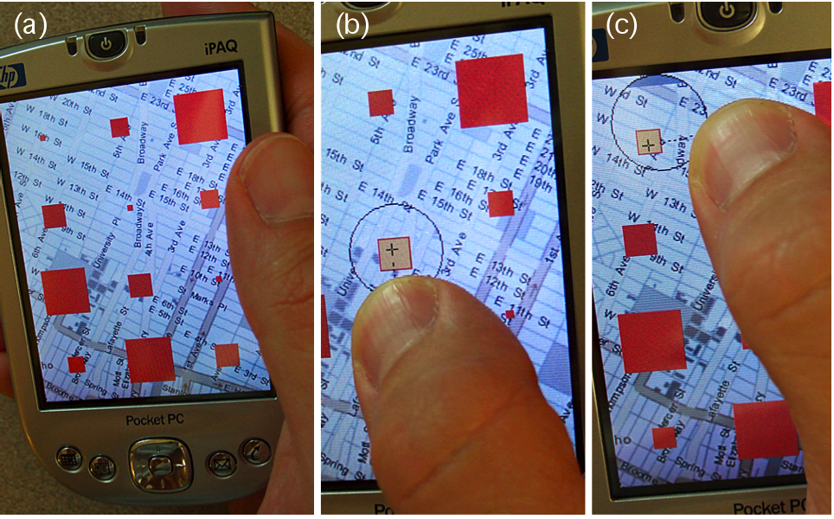
shift
Figure 1. (a) Small targets are occluded by a user’s finger. (b) The proposed Shift technique reveals occluded screen content in a callout displayed above the finger. This allows users to fine tune with take-off selection. (c) By adjusting the relative callout location, Shift handles targets anywhere on the screen.
problem you solve
your solution
benefit over prior art
= a mini abstract

Slide 49
Exercise: write the logical flow of your project using the-shortest-path approach

Slide 50
Final notes
Writing is tedious, so follow a strategy to minimize your efforts
Writing is hard, so give it enough time, and write it iteratively and get feedback often
Find a good paper that’s similar to yours as template
Follow the structure
Imitate its style of writing.
Additional resources:
https://docs.google.com/document/d/1k_T9uJnaSj6MjAm_C4soj6UO7GZ2_tD3B7aSTd19fl4

